Slide 1
Integrated Flood Management (IFM)
Integrated Flood Management: from theory to practice

Slide 2
Traditional Flood Management
Tradition is something positive, since it is related to old values and has often proofed effective during centuries.
Modern techniques are not necessarily positive just because they are recently developed
It’s not the question if a method is
modern or old
the question is if the method is adequate or inadequate to solve the problem
Problems are changing
Notes:
Flooding of areas used for socio-economic activities produces a variety of negative impacts.
Immediate impacts of flooding include loss of physical life, damage to property, destruction of crops, loss of livestock, non-functioning of infrastructure facilities and deterioration of health condition owing to waterborne diseases.
As communication links and infrastructure are damaged and disrupted, economic activities come to a standstill. Agricultural labourers are put out of work for long periods owing to the loss of crop seasons. Loss of livelihoods further reduces purchasing power and may indirectly affect production.
Frequent flooding, resulting in loss of livelihoods, production and other prolonged economic impacts and types of suffering can trigger mass migration or population displacement. Migration to developed urban areas creates overcrowding in the cities, end up living in marginal lands in cities that are prone to floods or other risks.
The loss of loved ones can generate deep impacts, especially on children. Displacement from one’s home, loss of property and livelihoods and disruption to business and social affairs can cause continuing stress.
The high cost of relief and recovery may adversely impact investment in infrastructure and other development activities in the area and in certain cases may cripple the frail economy of the region.
Ineffective response to relief operations during major flood events may lead to public discontent or loss of trust in the authorities. Lack of development in flood-prone areas may cause social inequity and even social unrest.

Slide 3
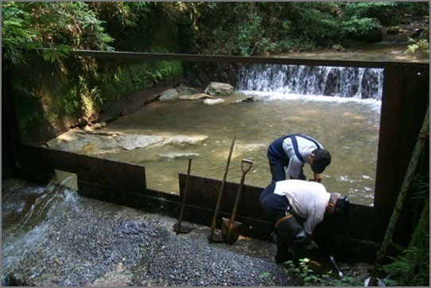
Traditional interventions of Flood Management
Emphasis on ‘Control’ rather than ‘Management’
River morphological behaviour is not factored
Structural measures generally disturbe eco-system balance and give a false sense of security to people
Rather than mitigating flood risk we largely succeeded in only shifting them spatially & temporarily
Planned in isolation from other development issues and on local scales (local and partial solution)
Problem primarily addressed based on engineering solutions (monodisciplinary)
Comprehensive flood management policies are neglected policy issues
Non-structural measures:
weak coordination
poor communication strategies
limited or passive community participation
Notes:
If flood are natural events, that have always happened and will always happen, how have we managed to face this?
Traditionally, focus has been on trying to control the floods, rather than managing them: structural measures (e.g. higher dykes, dams) have often been perceived as the only solution. As such, flood control was mainly an engineering problem (monodisciplinary). However, experience has shown us that these solutions have not always succeded, and often have magnified the flood impacts, shifting them to other places (e.g. another town, a neighbouring country, etc.); morover, these solutions have often neglected the natural morphological behaviour of the river, disturbing ecoystems and the related ecosystem services, and, most important in terms of life loss prevention, have incduced a false sense of security to people living in flood prone areas.
In this regard, William Hammond Hall, first State Engineer of California, rightly observed in 1880 that «There are two types of levees, those that have been overtopped by floodwaters, and those that are going to be ». Non strucutral measures (such as preparedness and response plans, in relation to early warning systems) have so far been perceived as « second choice », and therefore implemented with weak coordination, and communicated ineffectively to the population, resulting in a limited participation from the directly affected people living in flood prone areas.

Slide 4
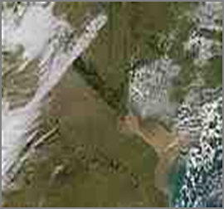
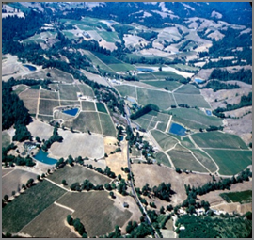
Paradigm shift required
From defensive to pro-active approaches;
From Ad-hoc to Integrated Flood Management
Towards a culture of prevention by managing flood risk & living with floods;
Balancing flood risk and achieving sustainable development needs;
Change in decision making processes to include risk management approaches.

Slide 5
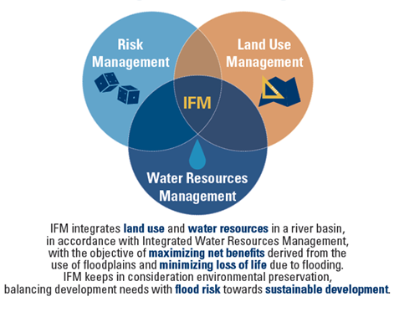
Integrated Flood Management definition
“Integrated Flood Management is a process that promotes an integrated, as opposed to fragmented, approach to managing floods.
IFM keeps in consideration environmental preservation, balancing development needs with flood risk towards a sustainable development”
Notes:
To illustrate graphically the issue, Flood risk is due to combination of a hazard (a hydro-meteorological extreme event), exposure (due to a poor, in not unexistent, land use planning), and vulnerability (due to lack of awareness of people living in flood-prone areas).
It is evident that this implies that flood risk mitigation is not only a purely technical or engineering problem, but has connections with other aspects related to economy, sociology, and policy.
Compared to traditional approach to flood management, usually focusing on structural measures, IFM integrates structural measures, other technical solutions as flood mapping, flood forecasting, etc. and activities involving the population (to increase their resilience) and policy issues (to regulate land use and optimize opportunities conciling flood management and development).
It should be kept in mind that no matter which solution is adopted, there will still be a residual risk (remember Hammond Hall...): to mitigate the impact of this residual risk, risk sharing otpions (e.g. Insurance schemes, natural catastrophe funds, solidarity plans) can be adopted.
NO SINGLE SOLUTION IS SUFFICIENT

Slide 6
Maximizing net benefits
Gains
Derived from the activities and use of floodplains (agriculture, urban development, transportation, recreational use, etc.)
Losses
Direct damages and mid to long term impacts on environment and socio-economics
0
>
Notes:
The overall objective of IFM is to Create a community than can protect itself with an optimal set of measures (both short and long term, structural and non structural)
Maximizing net benefits: ensure livelihood security, poverty alleviation and managing vulnerability
Minimizing loss of life in particular through end-to-end FF&W Systems and preparedness planning for extreme events
Sustainable development: balancing development needs and flood risks
Environmental preservation to ensure ecosystem health & services
What does it mean maximizing net benefits? It means that the difference between the gains derived from the use of floodplains and the losses due to periodical flooding should be positive.
The objective is not to avoid losses per se, at all costs (You can loose only if you have)
In this sense, declaring a flood prone area a “no entry” zone for future development may not necessarily be the good thing to do, as this would create an unnecessary obstacle to socio-economic development (e.g. promoting as an indicator of success the reduced number of people living in a T100 flood prone area: the Netherlands would have never prospered, or Bangladesh would be depopulated, if this approach had to be taken).
A certain amount of risk is acceptable, provided that what one could loss does not overcome the benefits deriving from taking the risk.
To make an example, a farmer may consider growing crops in a 10 years return flood prone area: every year he would have a 10% chance of getting flooded, and loosing the invested crop; but every year, he would have a 90% chance of getting good crops due to elevated yield of the regularly flooded terrain (rich in nutrients). At the same time, it would be quite stupid from his part to build on the same ground his house, farm, barn, etc., as the potential loss due to the flooding of these goods would probably overcome the benefits he would get in reducing time to commute to his workplace.
The driving force of human activity is to generate benefits.
Everybody must earn enough to survive today, before he cares about tomorrow. Tolerable losses are a constraint but not a goal. Thus flood management must be embedded in the overall economy (IFM)

Slide 7
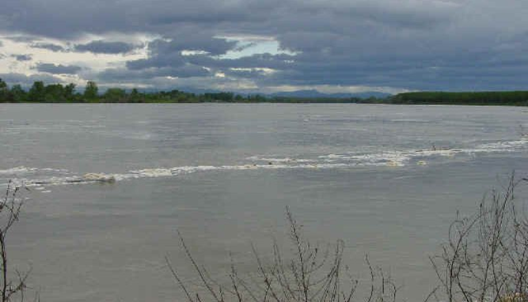
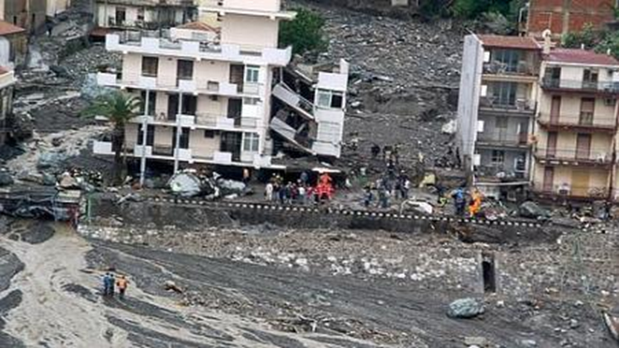
Risk Management: Hazards and disasters
“There are two types of levees, those that have been overtopped by floodwaters, and those that will be”
- William Hammon Hall, first State Engineer of California, 1880 circa
Natural hazards are unavoidable
BUT
Disasters are caused by social attitudes and developmental processes that increase vulnerability

Slide 8
IFM principles
IFM
1. Risk Management
2. River basin as a planning unit
3. Inter-disciplinary approach
4. Stakeholders participation
Notes:
It has to be clear that IFM takes into consideration the principles of:
1) Risk Management (as in the picture)
2) Managing the Water Cycle as a Whole (considering not only the river, but also the river basin and the interactions between the two) and Integrate Land and Water Management (River basin as a planning unit)
3) Interdisciplinary - Adopt the Best Mix of Strategies (not only an engineering problem)
4) Ensure a Participatory Approach (Seeks all stakeholders’ participation)

Slide 9
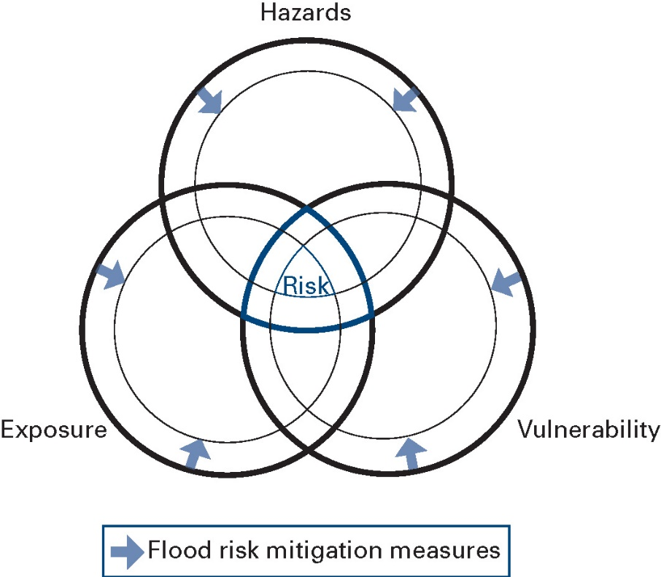
1. Risk Management
Probability x Consequence
Hazard x Exposure x Vulnerability
Example of floods:
Hazard: probability of a particular discharge or water level at a particular place
Exposure: Land and assets in the inundation area of that flood
Vulnerability: ability/disability of the people or assets to withstand, cope with or recover from the negative effects of that flood

Slide 10
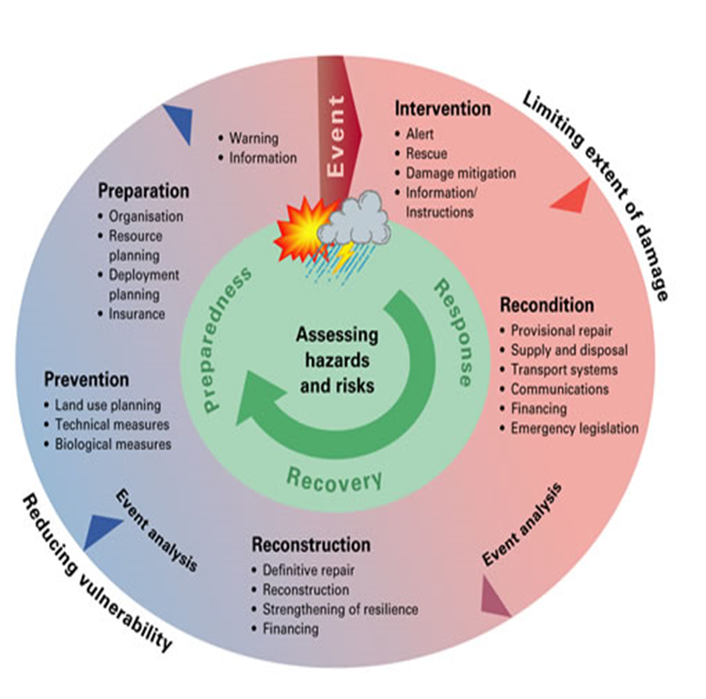
Risk Management
Preparedness: to ensure effective response
Response: to reduce adverse impacts during the flooding
Recovery: to increase the resilience of affected communities
Keep an eye on Residual risks!
Risk assessment indispensable (e.g. risk maps)
Notes:
Absolute protection from floods is a myth. No matter what strategies are adopted to reduce flood risks, there will always be some residual risks. Flood emergency management form an integral part of flood risk reduction. Flood emergency management is aimed at managing and minimizing the damaging effects of flooding, once the flood waters come in contact with human and economic activities. The objective is to avoid the exposure of critical activities and temporarily shift people and such activities from flood-prone areas, thereby reducing the negative impacts of flooding on the community.
Emergency management requires cooperation across sectors and administrative levels. In addition to resource mobilization, continuous, timely and precise information flow is vital for handling emergency situations.
Flood emergency management is a continuous process from flood preparedness to ensure effective response, emergency response to reduce adverse impacts during the flooding and post-disaster recovery to assist the affected community to rebuild itself. The development and implementation of flood emergency management strategies call for regular review and revision. Lessons learned and good practices of one flood year during response and recovery need to be integrated into future plans.

Slide 11
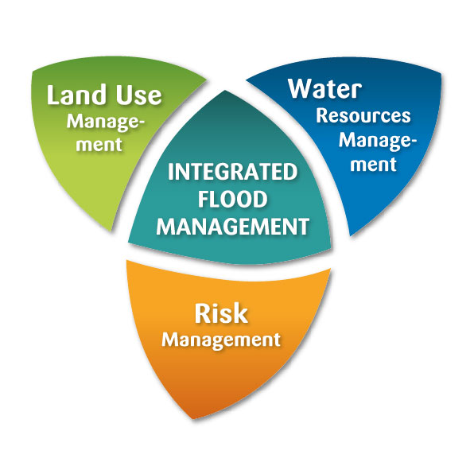
2. River Basin as a planning unit
Integration of :
Land and Water Management
Upstream and Downstream
Structural and Non-structural
Short-term and Long-term
Local and Basin Level Measures
Top Down and Bottom Up Decision Making
Development Needs with Ecological and Economic Concerns
Functional Integration of Institutions and Stakeholders
Notes:
Integrated Flood Management (IFM) refers to the integration of land and water management in a river basin using a combination of measures that focus on coping with floods within a framework of IWRM and adopting risk management principles while recognizing that floods have beneficial impacts and can never be fully controlled.

Slide 12
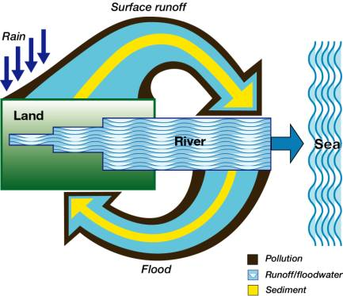
Water cycle to be considered as a whole
Recognition that a river basin is a dynamic system with many interactions/fluxes between land and water bodies
Flood and drought management
Effective use of flood waters
Ground water and surface water interaction in flood plains
Flood Management is not only water management but also strongly linked to land management and pollution control
Notes:
Integrated Flood Management (IFM) refers to the integration of land and water management in a river basin using a combination of measures that focus on coping with floods within a framework of IWRM and adopting risk management principles while recognizing that floods have beneficial impacts and can never be fully controlled.

Slide 13
3. Interdisciplinarity
Law
Social sciences
Hydrology
Engineering
Economy
Scientific domains
Space
International
National
High waters, floods
Time
Basin
Reconstruction and rehabilitation
Local
Low waters, drought
Emergency
The “dimensions” of IFM
Planning
interdisciplinarity, flexibility, participation
Notes:
IFM integrates and mixes strategies
- Structural and Non-structural
- Short-term and Long-term
- Local and basin level measures
Balances development needs and environmental concerns
Addresses all aspects of Flood Management
- Scientific and Engineering
- Social Aspects
- Environmental Aspects
- Economic Aspects
- Legal and Institutional Aspects
- Adaptive Management

Slide 14
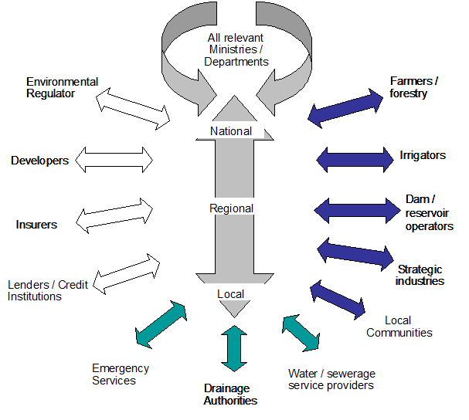
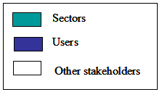
4. Stakeholders participation
Involvement of all stakeholders in the dialogue/ decision-making process
Decentralization of decision-making with appropriate mechanisms
Optimal mix of bottom-up and top-down approaches
Effective conflict resolution mechanisms
Notes:
The effectiveness of an IFM approach depends largely on mobilizing and rallying for greater stakeholder participation from the start. Greater participation of all stakeholders in flood policy development is considered vital since it enables inhabitants of flood-prone regions to choose the level of risks they are ready to take.
Ensure implementation of basin flood management plans with full public support
Ensure sustainability of plans and associated decisions
Build consensus and public support on the flood management options
Build stakeholders commitment
Build resilience of flood-prone communities
Provide all stakeholders, including the public, with full opportunities to share their views and influence the outcome

Slide 15
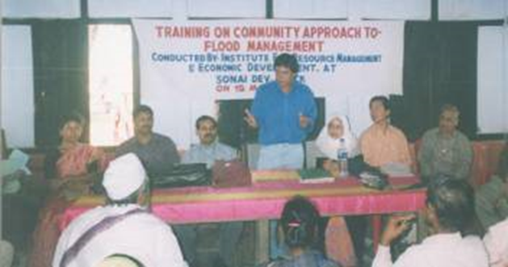
Why stakeholders involvement
Ensure implementation of basin flood management plans with full public support
Ensure sustainability of plans and associated decisions
Build consensus and public support on the flood management options
Build stakeholders commitment
Build resilience of flood-prone communities
Provide all stakeholders, including the public, with full opportunities to share their views and influence the outcome
Notes:
The effectiveness of an IFM approach depends largely on mobilizing and rallying for greater stakeholder participation from the start. Greater participation of all stakeholders in flood policy development is considered vital since it enables inhabitants of flood-prone regions to choose the level of risks they are ready to take.

Slide 16
Putting IFM in practice: Requirements
Clear and objective policies
Comprehensive assessment and understanding of development opportunities and flood risks;
Multi-sectoral approach to reach the objectives;
Appropriate legislation and regulations; and
Innovative economic instruments.
Adaptive Management
with a multidisciplinary approach
Appropriate Institutional structures for proper coordination and linkages;
Enabling participatory processes; and
Information management and exchange mechanisms.

Slide 17
Towards a sustainable development
IFM integrates and mixes strategies
Structural, Non-structural and Living with Floods
Short-term and Long-term
Local and basin level measures
Balances development needs and environmental concerns
Addresses all aspects of Flood Management
Scientific and Engineering
Social Aspects
Environmental Aspects
Economic Aspects
Legal and Institutional Aspects
Adaptive Management
Sustainable Development "meets the needs of the present without compromising the ability of future generations to meet their own needs.”
In IFM reference is mainly the use of flood plains

Slide 18
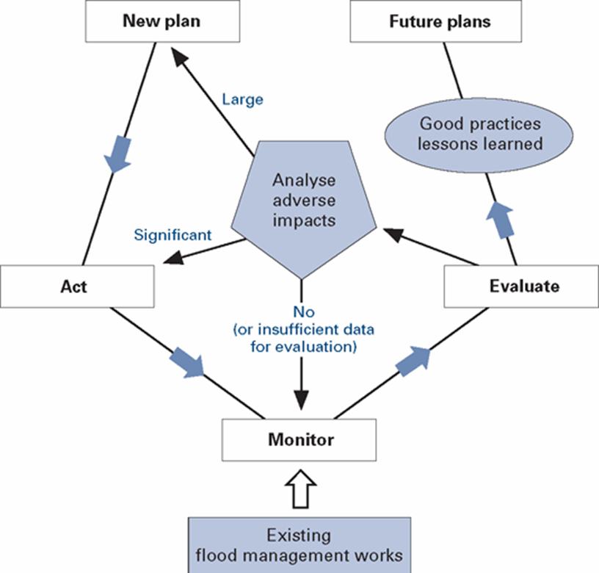
IFM: Adaptive Management

Slide 19
Conclusions
Rapidity of development means there is a chance now to address the wider sustainability of flood management
Pragmatism → not dogmatism: project planning offers an array of opportunities to apply IFM principles
A set of agreed principles for flood management should be instrumental in reconciling competing interests
IFM is about “negotiated„ or “best compromise„ not “optimal solutions„ : a broader set of stakeholders/parnters involved
IFM requires capacity building within the decision making authority and all stakeholders

